Slide 1
FEEDBACK FORMS
Team members :
N.Sowmya-19XJ1A0541
S.Sanjana-19XJ1A0561
Sree Deepya. B-19XJ1A0575

Slide 2
FEATURES:
Java Swing was used for User Interface(UI).
MYSQL was used for Database.
JDBC which is an API was to connect the front end and database.

Slide 3
INTRODUCTION:
This project is about feedback forms.
This Feedback form collects feedback about Professors from Students.
The First Frame is a login page which is used by Professors and Students to login.
There is also signup option in First Frame, which leads to signup frame for students and professors.
When a Student logs in, they enter the Course Selections Frame.
The Course Selection Frame consists of the courses.
After selecting the course, they enter the Feedback Frame.

Slide 4
The Feedback Frame consists of questions related to the course.
When a Professor logs in, they enter into prframe , in which there will be no of subjects that particular professor teach.
After choosing the subject ,professor enters Display frame.
The Display Frame consists the statistics of the Feedback Form.

Slide 5
Previously there was just one login password for students and for professors, but with the help of MYSQL the User can set there own password.
Professors were not able to access the other subjects they were teaching, but with the help of MYSQL they can access all the subjects they are teaching.

Slide 6
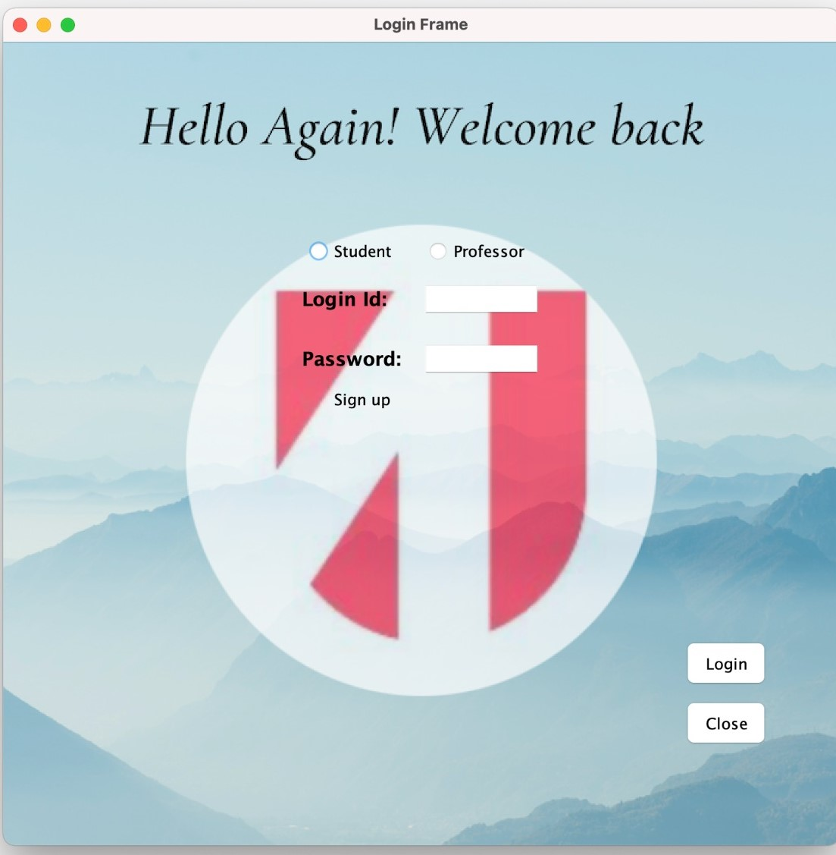

Slide 7
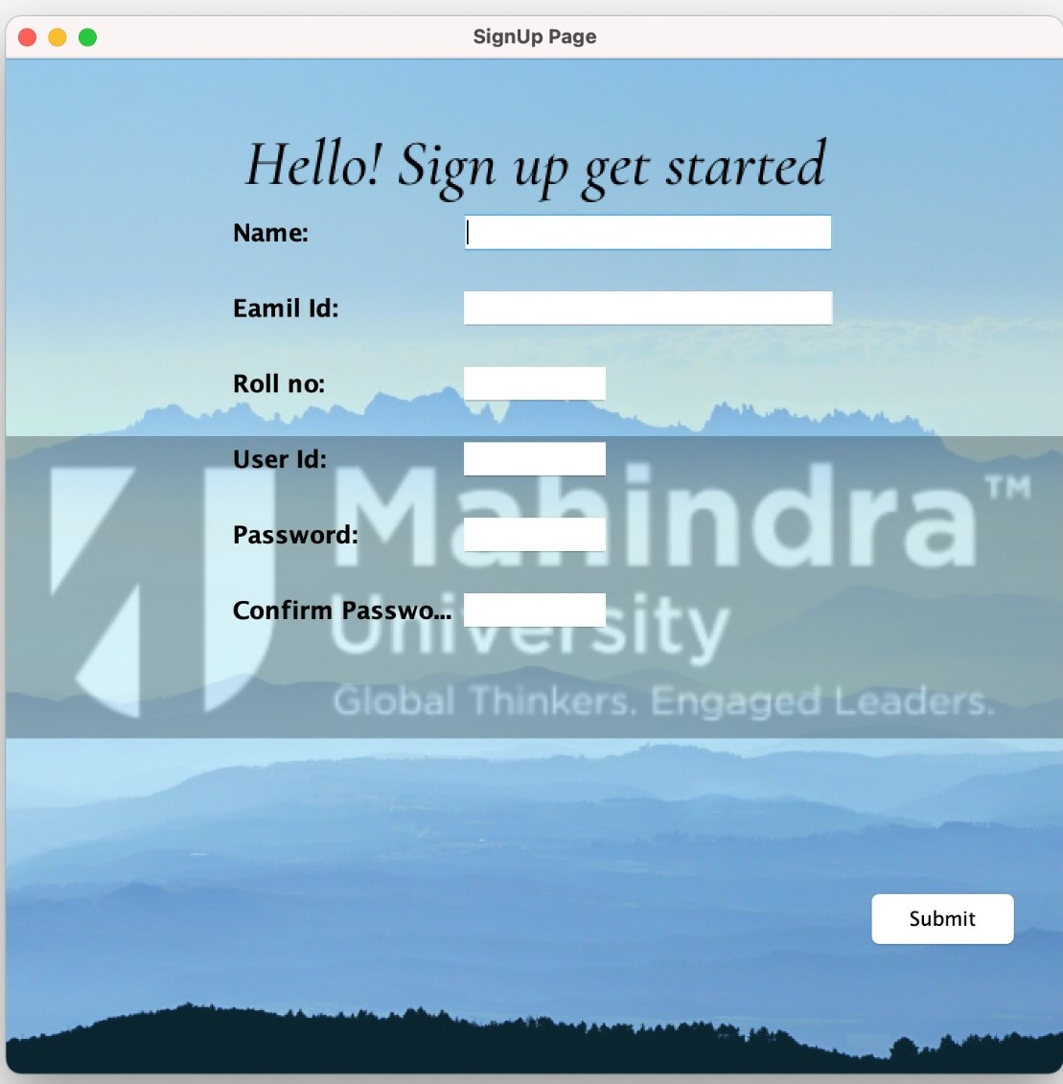

Slide 8
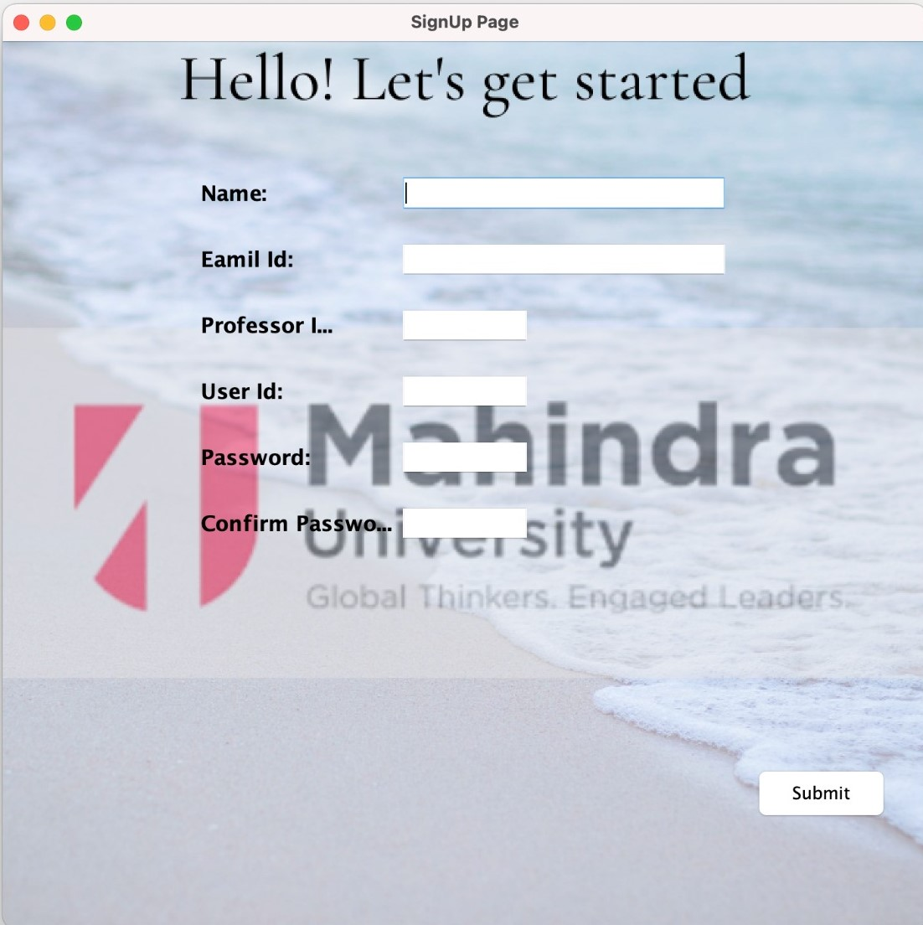

Slide 9
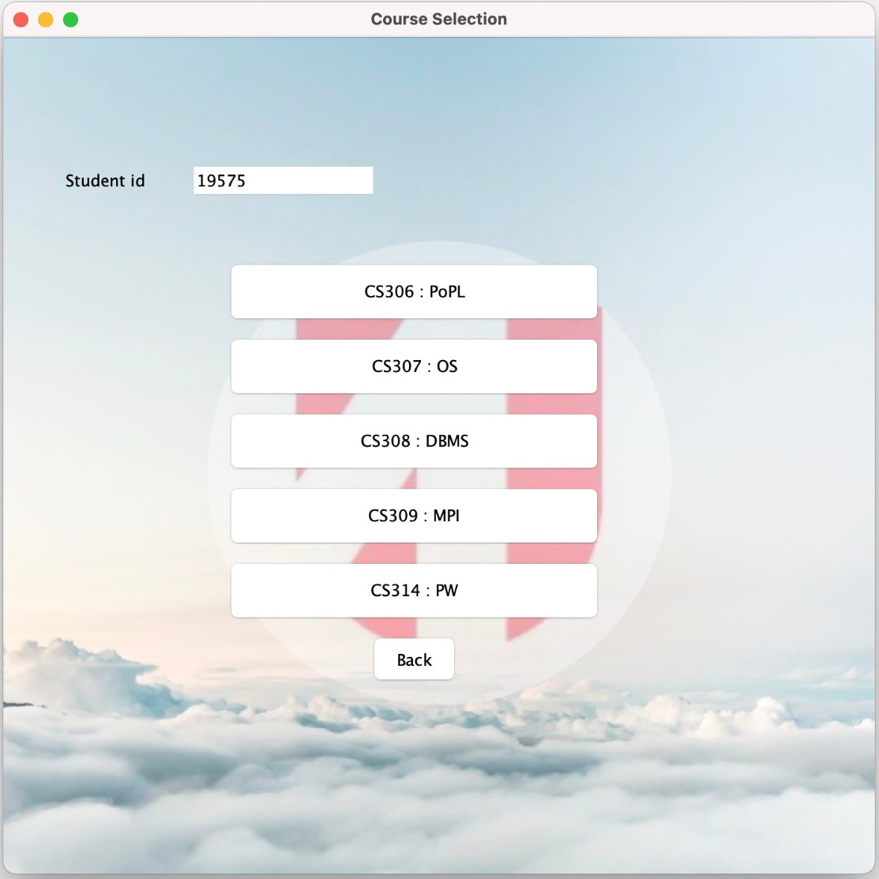

Slide 10
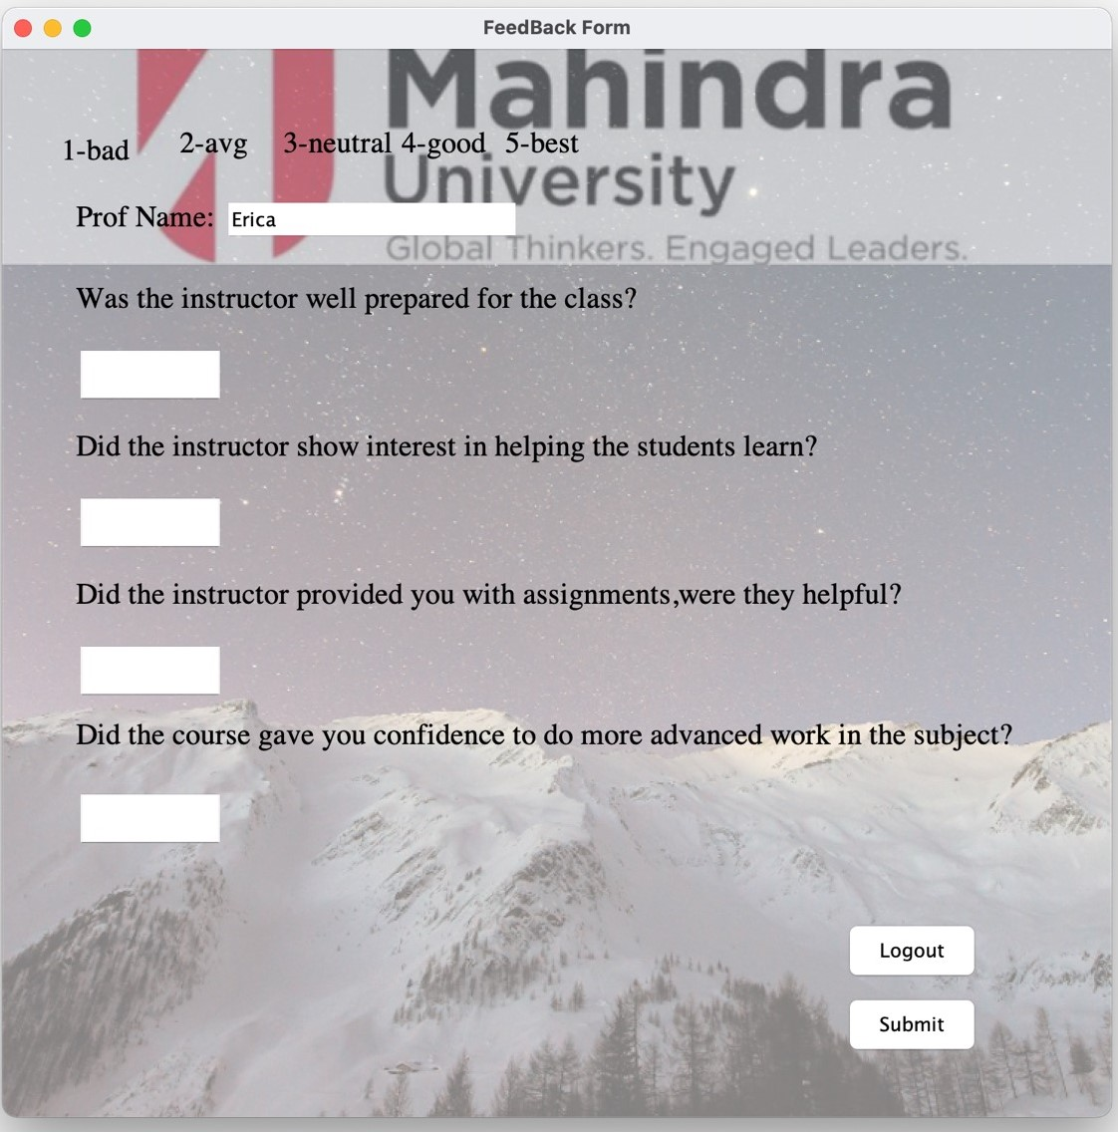

Slide 11
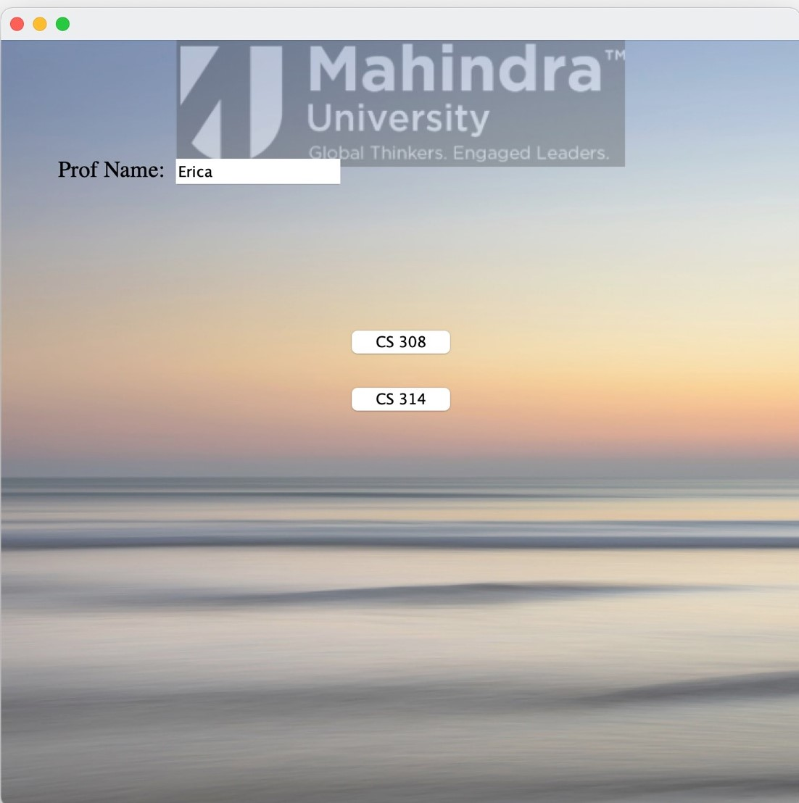

Slide 12
